Slide 1
Pulse Monitor
PHYS 319 Shiori Kuboki

Slide 2
Brief description
Monitors pulse by monitoring the amount of infrared light that passes through your finger
When a ‘pump’ of blood passes through your finger, it creates a brief moment of opacity, which it monitors
The light is sensed using a phototransistor
It’s like those ones that you see beeping in Surgical shows!

Slide 3
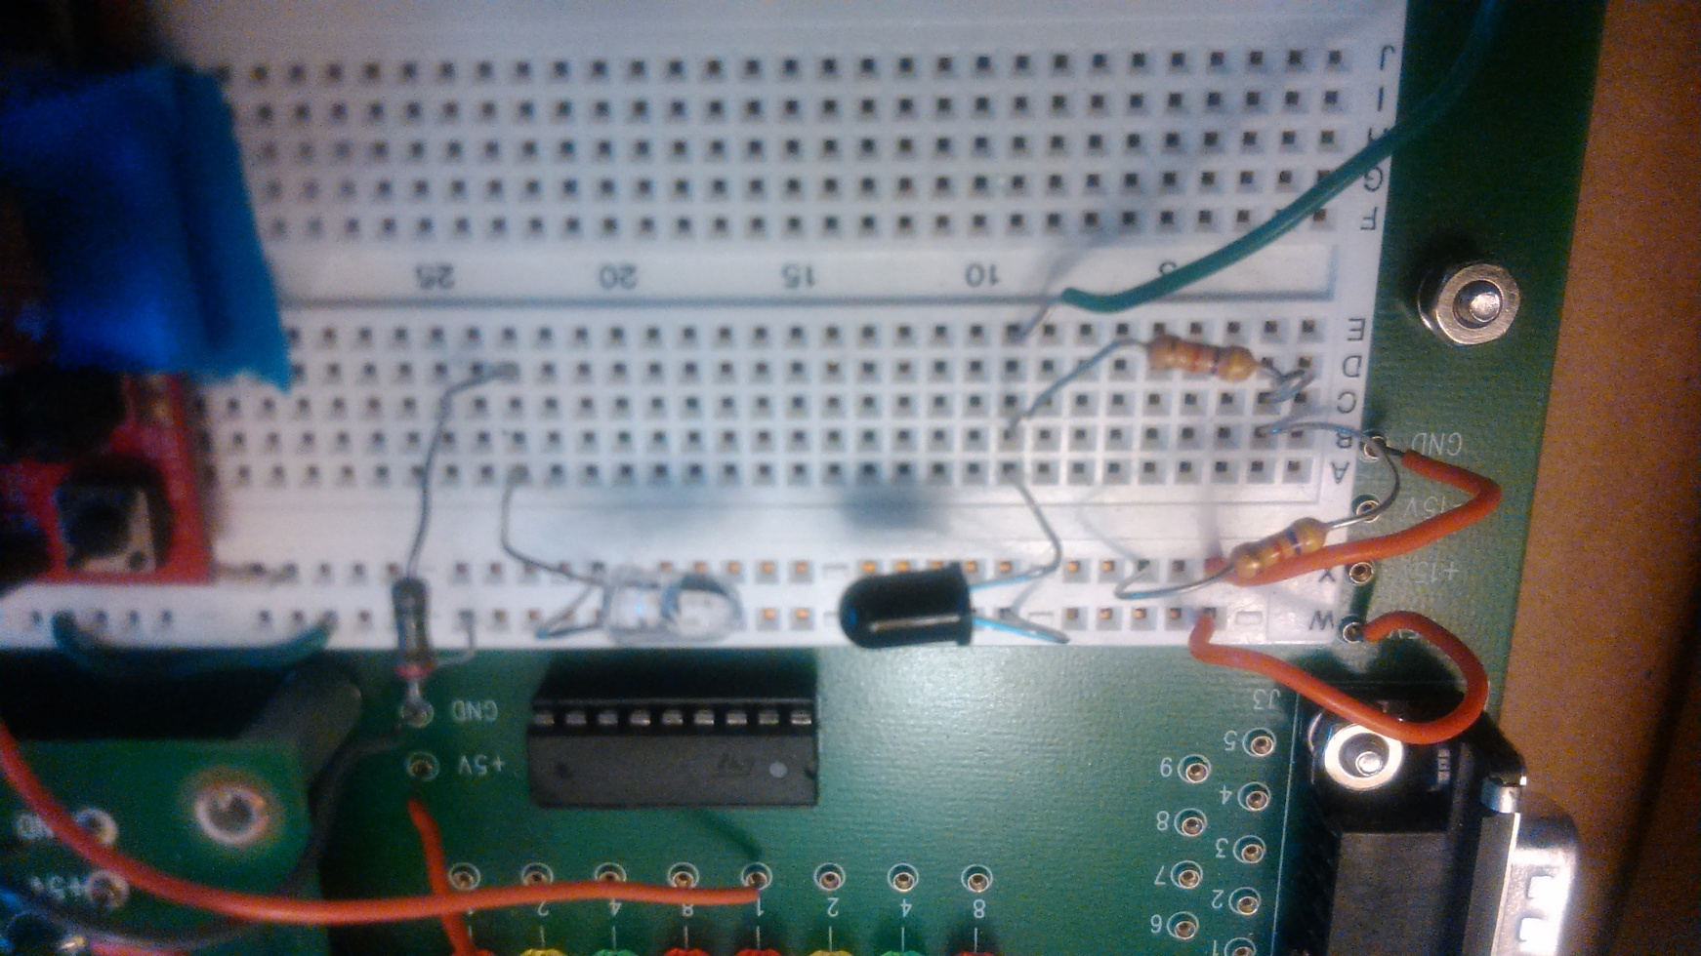
Infrared LED & Phototransistor

Slide 4
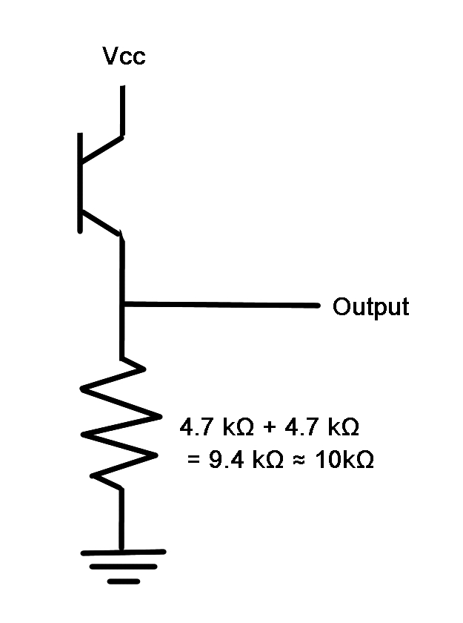
Infrared LED & Phototransistor
Vcc
Phototransistor
Resistors
GND

Slide 5
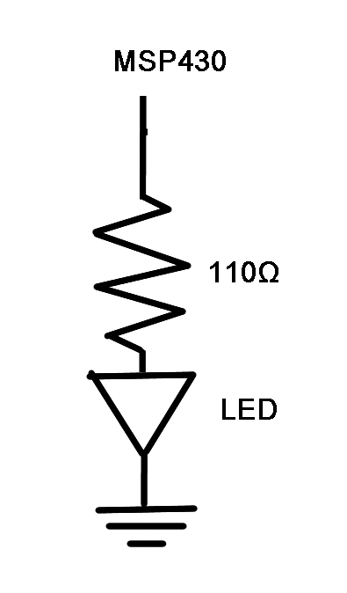
Infrared LED & Phototransistor
HSDL4220 LED
GND
Resistor
MSP430

Slide 6
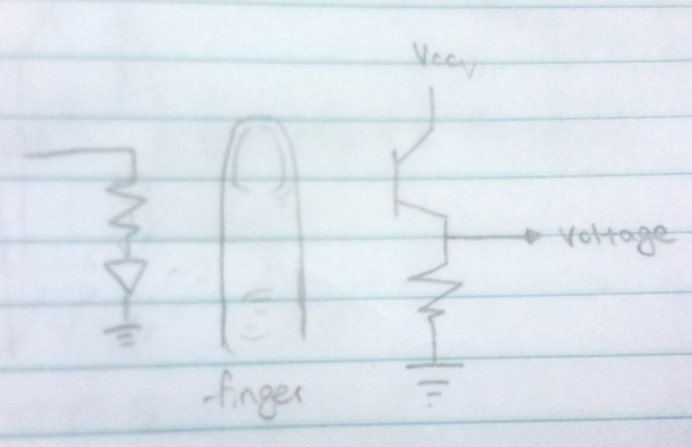
Infrared LED & Phototransistor

Slide 7
AMPLIFIER
The voltage from the LED and the phototransistor were very weak (the amount of light that blood flow blocks is very little)
So, remove unneeded noise and amplify the data using Op-Amps

Slide 8
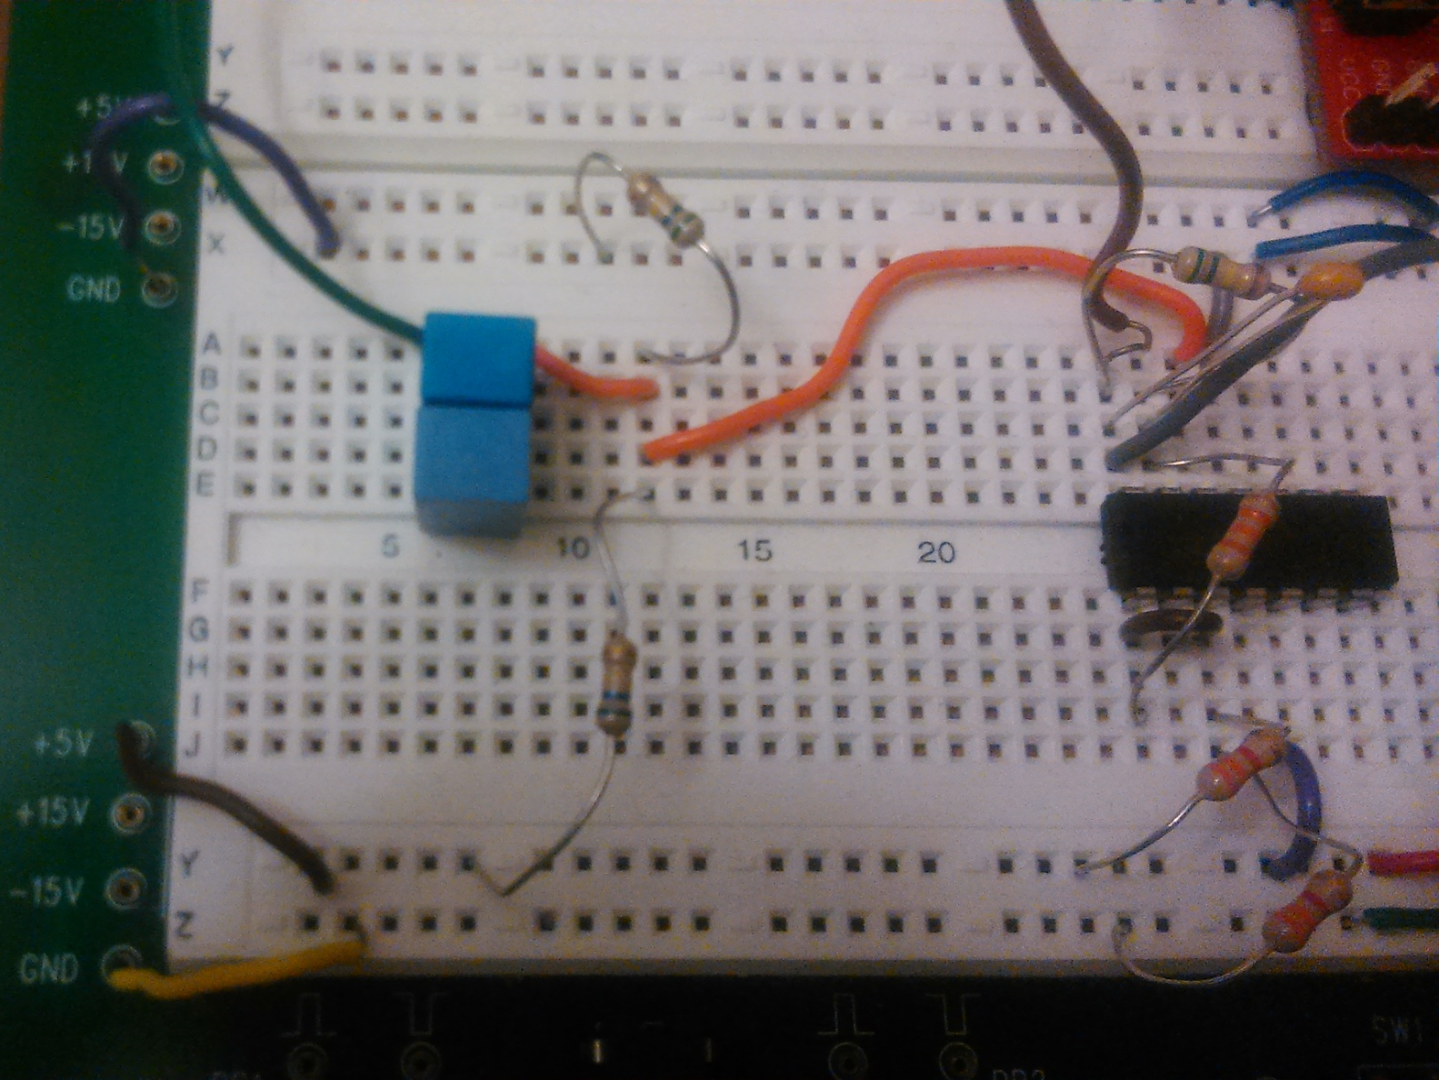
AMPLIFIER

Slide 9
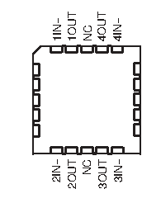
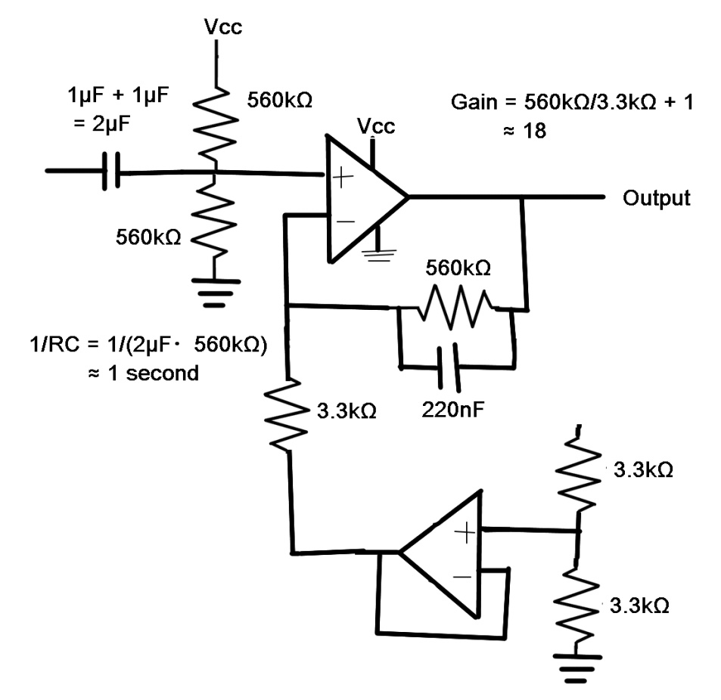
AMPLIFIER

Slide 10
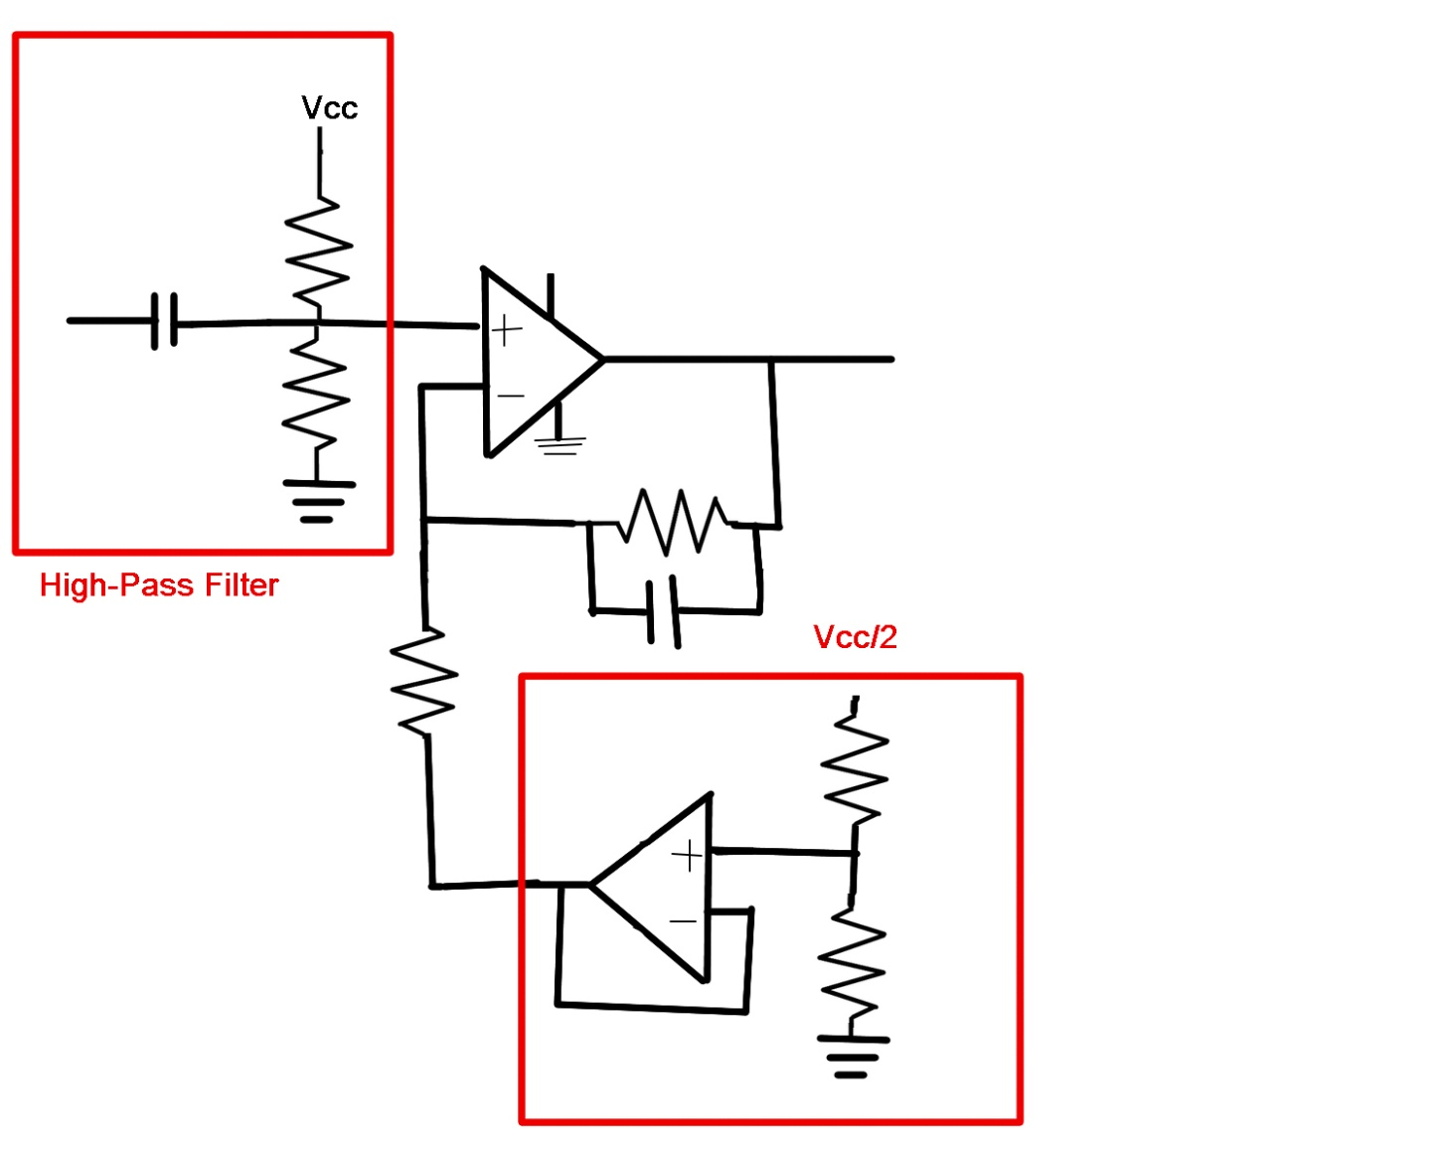
AMPLIFIER

Slide 11
AMPLIFIER

Slide 12
Comparator
The output after the amplifier is now clean, but it is in a waveform, so it is difficult to send information to the MSP430 in this way
So, use a comparator to change this waveform into a square wave
The comparator voltage can be adjusted using the variable resistor

Slide 13
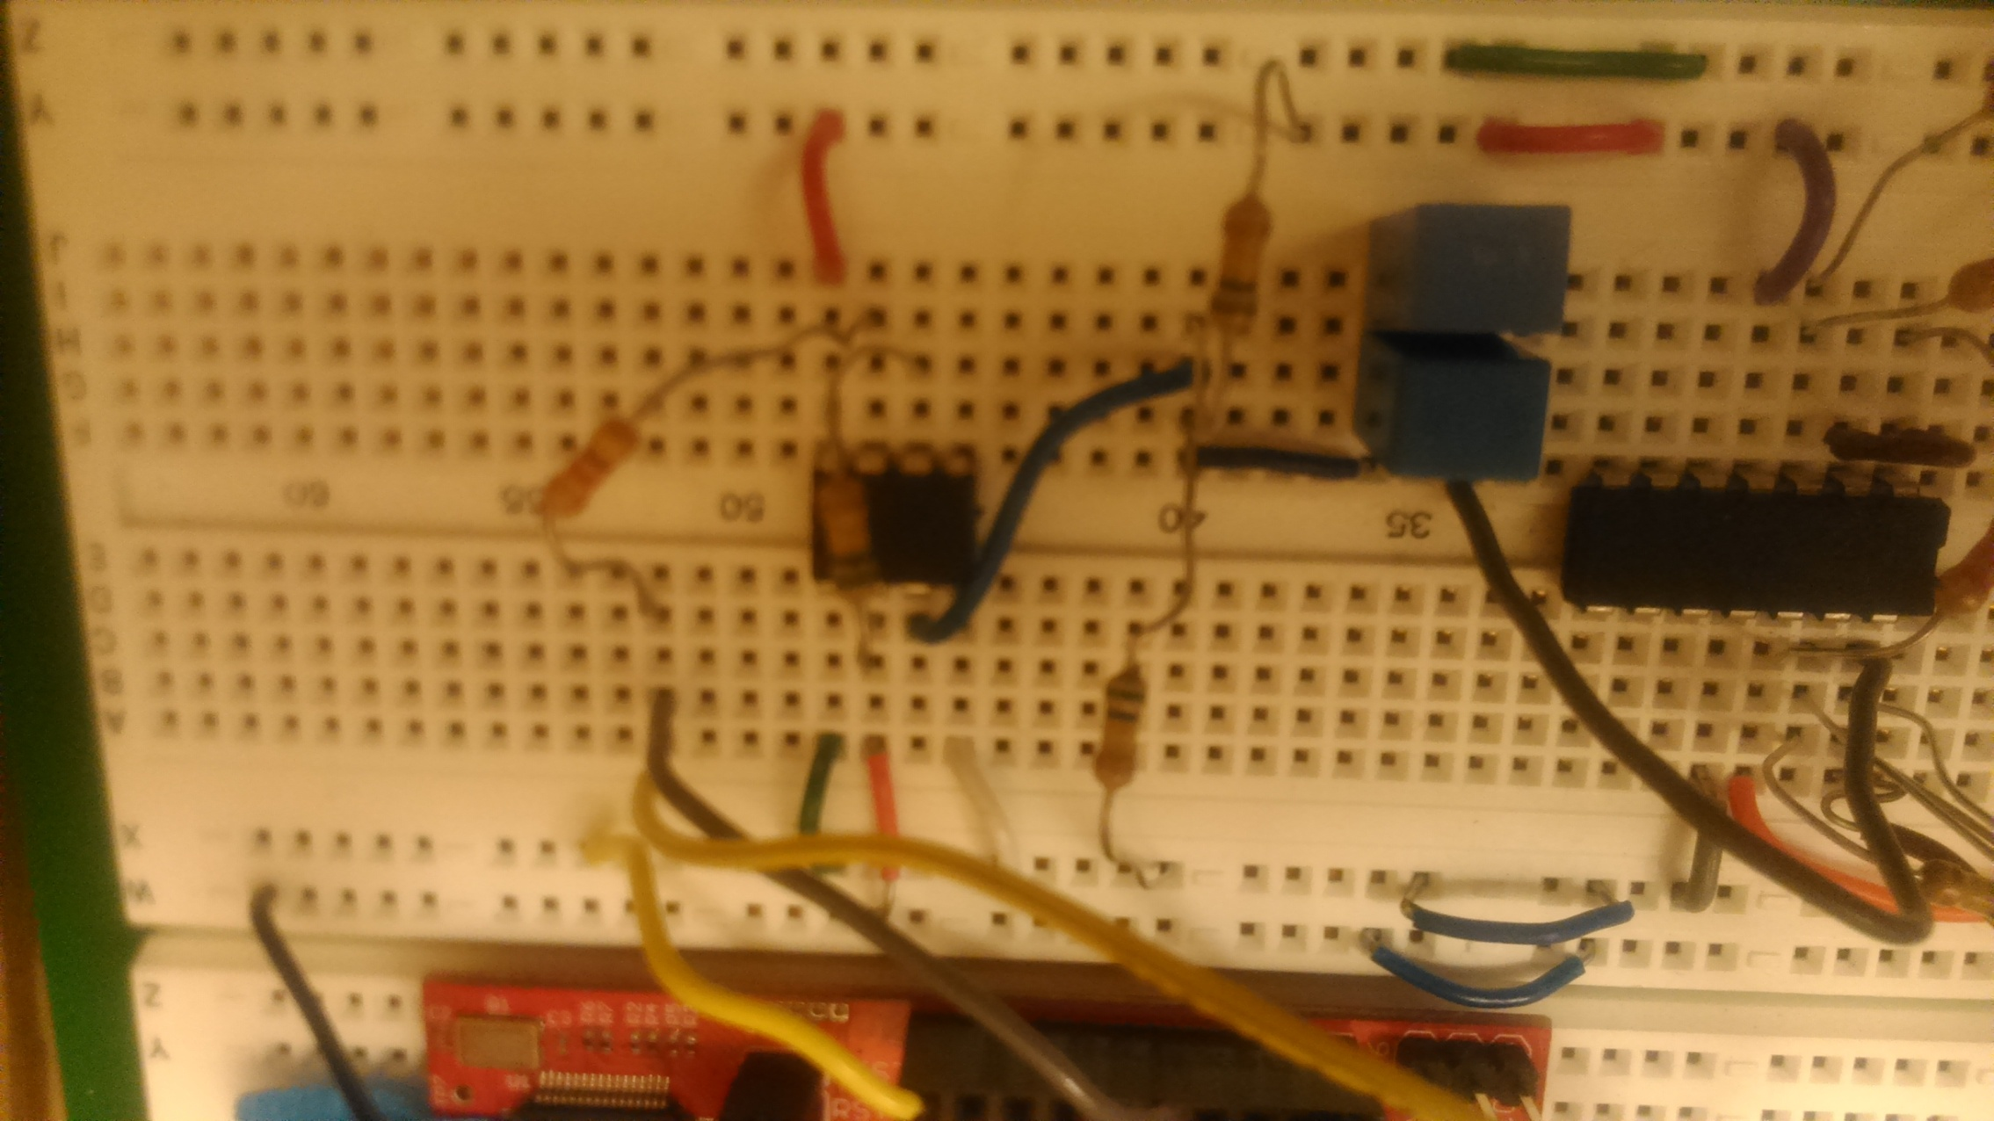
Comparator

Slide 14
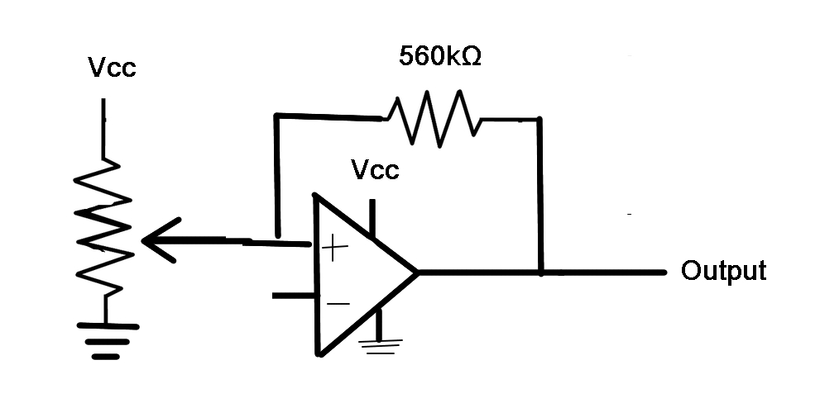
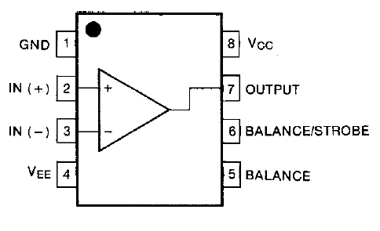
Comparator

Slide 15
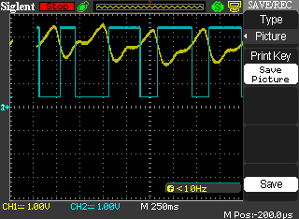
Comparator

Slide 16
Comparator

Slide 17
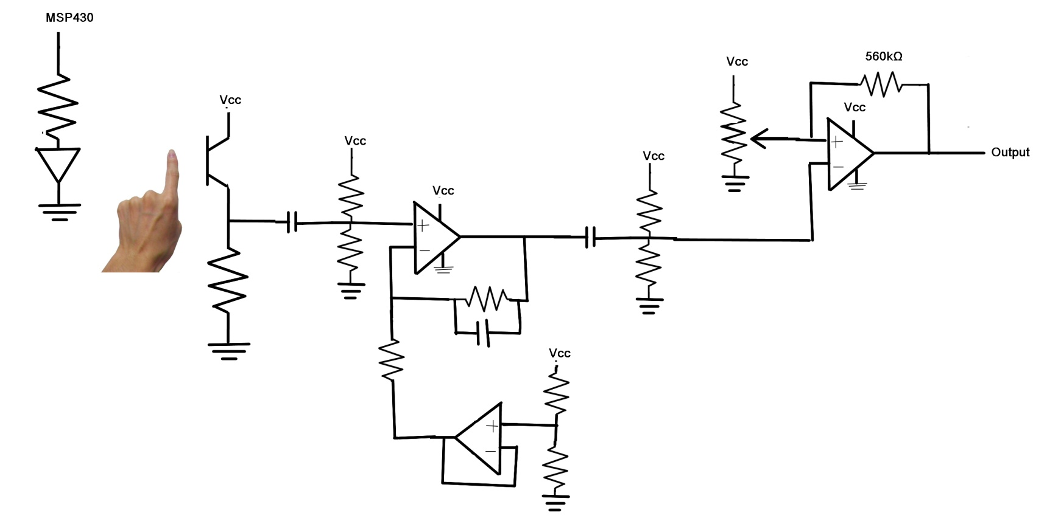
Circuit

Slide 18
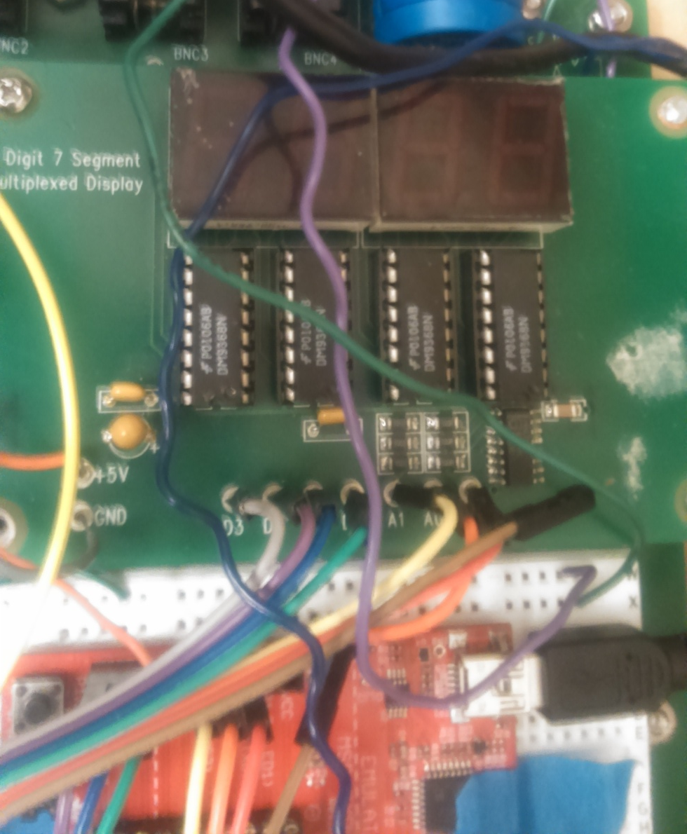
7 Segment LED & External LED
Added 7-segment display to show heart rate, and an external LED that blink every time your heart beats

Slide 19
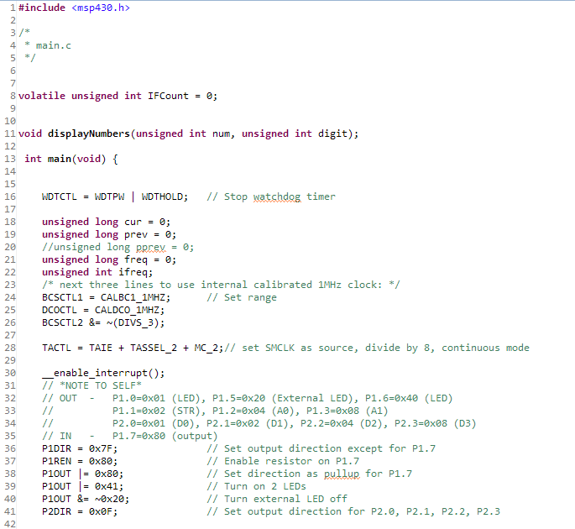
CODE

Slide 20
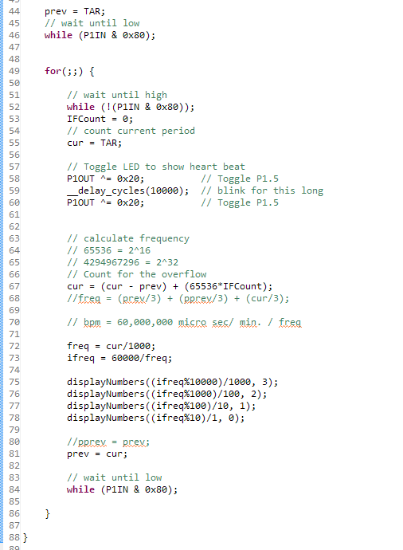
CODE
1 beat X beats
￣￣￣￣ = ￣￣￣￣
Y μsec. 1 min.
X = 1/Y * 60*1000000

Slide 21
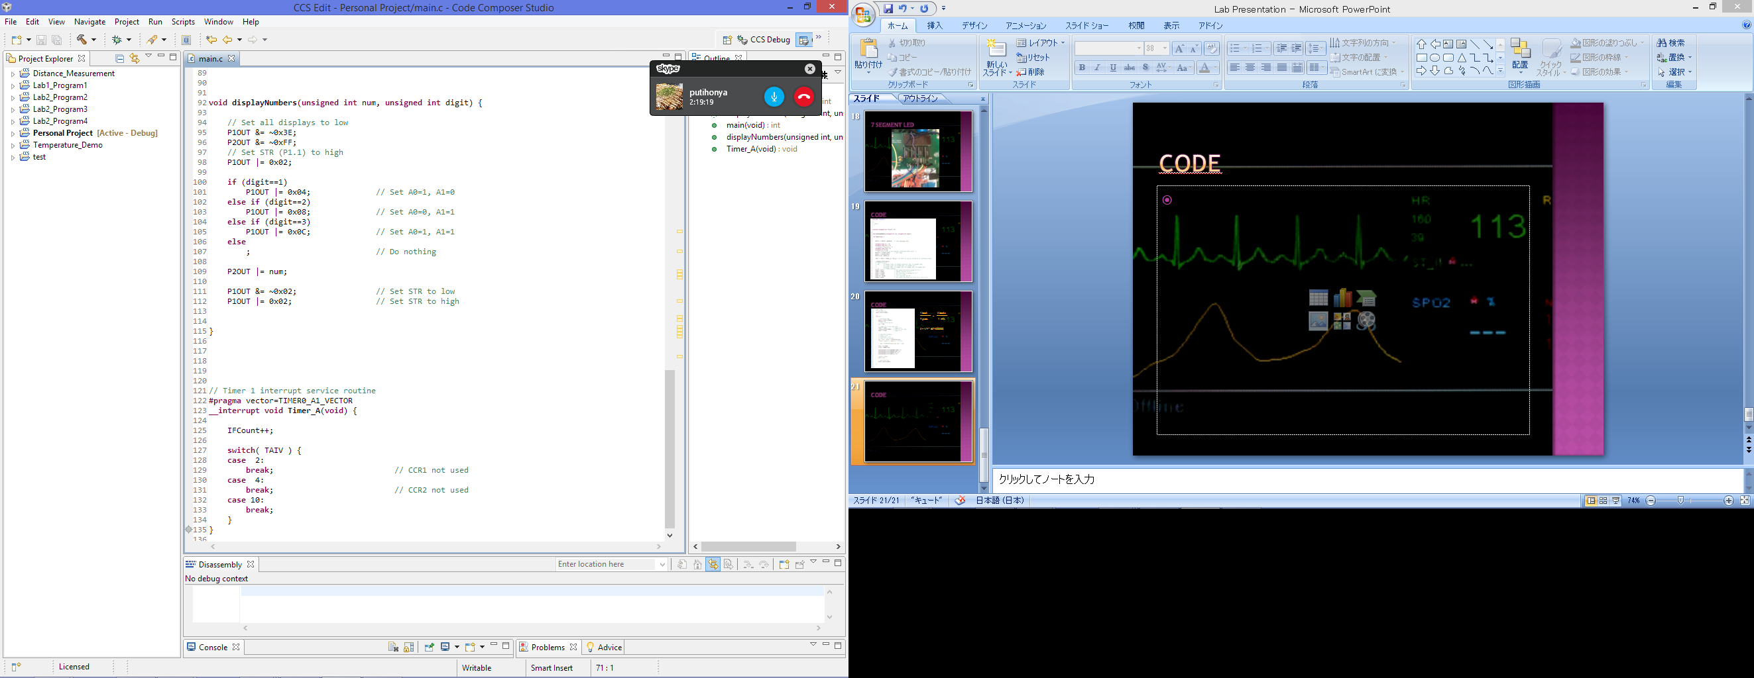
Code

Slide 22
Code

Slide 23
What was difficult
What was the most difficult was setting up the interrupt flags for overflows
At first, I didn’t even figure out why my pulse rate was so high (and wrong), which turned out to be because there were overflows in TAR
The implementation of counting the overflows were also difficult, since I had difficulty trying to figure out where to put my ‘IFCount++;’ inside my code
Another difficulty was debugging the code
For some reason, CCStudio does not let us put breakpoints at certain places in code
Also, the printf function is too big for the CCStudio thus it does not support it, which made debugging even more difficult

Slide 24
What was easy
What was easy is connecting the MSP430 to the 7-segment display
We had done a lab before using the 7-segment display, and I have also encountered it multiple times previously, so it was easy to implement
To be able to see waveforms and voltages on the oscilloscope was also very helpful for many parts of the lab

Slide 25
What I could do better
My 7-segment display goes back to the value 0 every other time, and I could not figure the reason out by today
It would’ve been really cool if I could’ve used a beeper to make it beep when the pulse is below some rate, but because of this, it would not have worked
Wanted to base the heart rate calculation using the past 2 measurements, but it did not work out very well, so I had to use just the current measurement
If I had time, I would’ve also liked to plot things on Python

Slide 26
END
Thanks for listening!

